Slide 1

Introduction to Deep Learning
Supervised Learning
with Neural Networks
deeplearning.ai
Notes:
So far most economic value from neural networks were created in supervised learning.

Slide 2
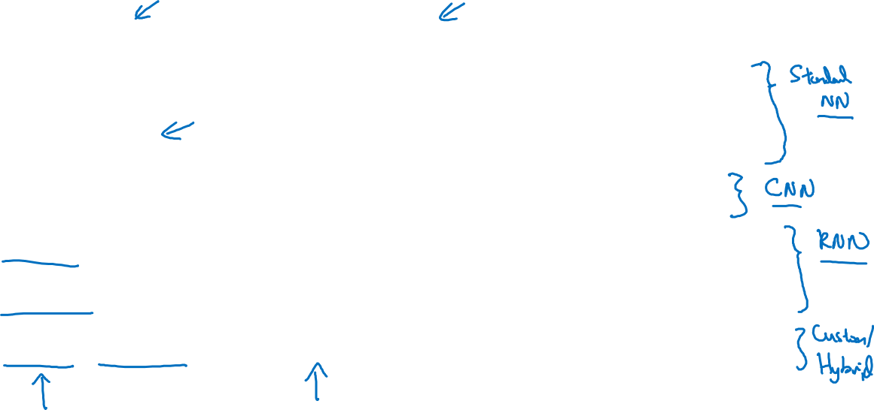
Supervised Learning
Input(x)
Output (y)
Application
Home features
Price
Real Estate
Ad, user info
Click on ad? (0/1)
Online Advertising
Image
Object (1,…,1000)
Photo tagging
Audio
Text transcript
Speech recognition
English
Chinese
Machine translation
Image, Radar info
Position of other cars
Autonomous driving
Notes:
Online adverting, neural networks have become very good at determining whether a user will click on an add or not.
Different types of NN are useful for different types of problems. For example, audio is a one dimension time series or one dimension temporal seq , for seq data we mostly used RNN.

Slide 3
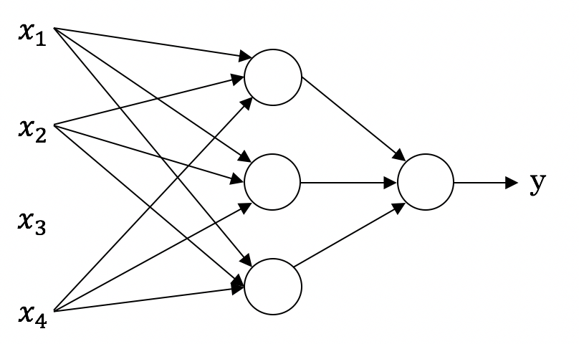
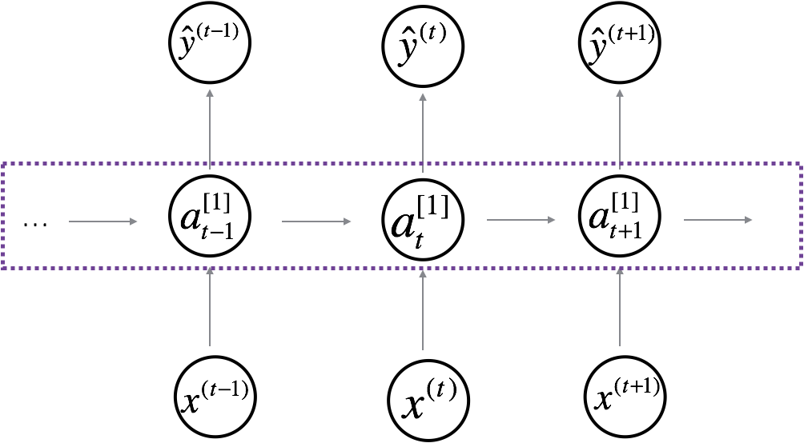
Neural Network examples
Standard NN
Convolutional NN
Recurrent NN

Slide 4
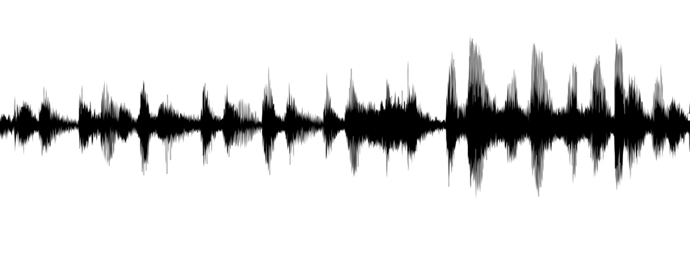


Supervised Learning
Structured Data
Unstructured Data
Size | #bedrooms | … | Price (1000$s)
2104 1600 2400 ⋮ 3000 | 3 3 3 ⋮ 4 |  | 400 330 369 ⋮ 540
Audio
Image
User Age | Ad Id | … | Click
41 80 18 ⋮ 27 | 93242 93287 87312 ⋮ 71244 |  | 1 0 1 ⋮ 1
Four scores and seven years ago…
Text
Notes:
Structured can broadly means databases so we call it a Structured data. Every feature has a well defined meaning.
In case of un-structured data, features could be individual words, or pixel values, computer cannot really make sense in this case, therefore we have to train. Computers have recently become good at interpreting this type of data.

